Slide 1
Energy From Nucleus
Presented By
Student Name’s : ABDUL RAFEH
Student ID : CSC-20S-104
Section : CS I - C
Course Instructor : Naeem Akhter samoo

Slide 2
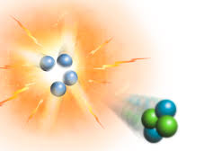
What is Nuclear Energy?
Changes to atomic nuclei can release tremendous amounts of energy.
The nuclear energy is released mainly in the form of the heat(and some light).
Nuclear energy is also called atomic energy because it comes from the atom.

Slide 3
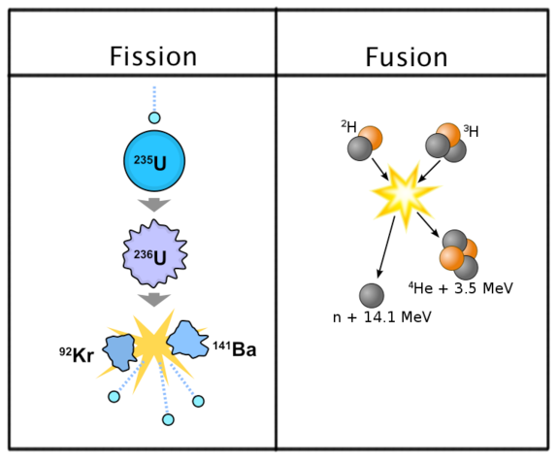
TWO WAYS TO OBTAIN NUCLEAR ENERGY:
Nuclear Fission
Nuclear Fusion

Slide 4
What is Fusion
Fusion is nuclear reaction in which matter is converted to energy.
In nuclear fusion, two or more nuclei that have small masses combine to form a larger nucleus.
Two positively charged nuclei repel one another. In order to fusion to occur, they must be forced very close together.
Fusion requires very high temperatures—more than 100,000,000°C.
At this temperature, the electrons are removed from atoms, forming a state of matter called plasma.

Slide 5
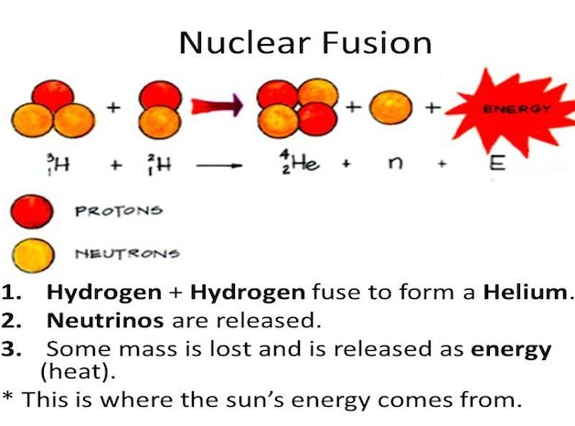
Continue...
In plasma, the positive nuclei and electrons are separated.
This happens in the core of the sun and other stars.
Hydrogen nuclei in sun fuse to form helium nuclei as shown in the figure below.

Slide 6
What is Nuclear Fission?
The nuclei of some atoms decay by breaking apart. They then form two smaller nuclei that are more stable.
During nuclear fission, a large nucleus splits into two smaller nuclei, releasing energy at the same time.
Some large atoms, including some isotopes of uranium, break apart naturally by nuclear fission.
These kinds of large atoms can also be forced to undergo fission.
This is done by hitting the nucleus of an atom with a neutron, as shown in the figure below.

Slide 7
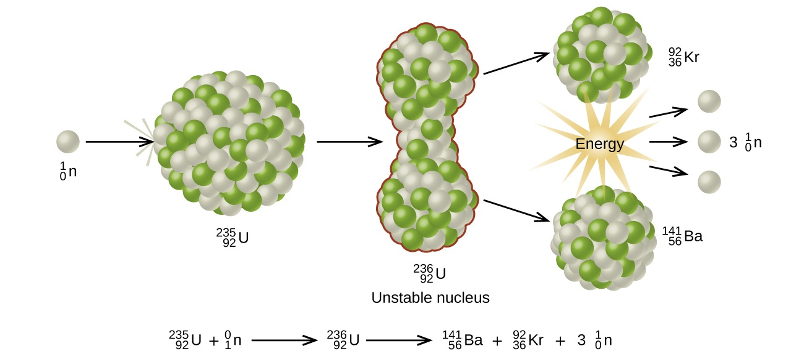
Continue...
Fission of a Uranium-235 Nucleus

Slide 8
What is a nuclear chain reaction?
What happens to the three neutrons shown as products of the fission of uranium-235?
If they each hit another uranium-235 nucleus and those nuclei split, the fission would produce nine more neutrons.
If the neutrons continue to cause fission, the result is a nuclear chain reaction. In a nuclear chain reaction, a continuous series of nuclear fission reactions occurs.

Slide 9
Two Types of Chain Reaction:
Uncontrolled chain reaction: It occurs in Atomic Bomb.
Controlled chain reaction: It happens in Nuclear Reactors or Power Plants.

Slide 10
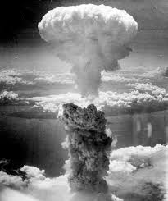
Energy From The Uncontrolled Chain Reation:
In an uncontrolled chain reaction, huge amounts of energy are released very quickly.
An exploding atomic bomb is an example.
Keeping some of the neutrons from hitting uranium nuclei can control the nuclear chain reaction.
Then energy is released but not fast enough to cause an explosion.

Slide 11
Energy From The Controlled Chain Reaction:
Nuclear power plants use controlled chain reactions.
They change the energy from the fission of uranium fuel into electrical energy.
Control rods are made of materials that absorb neutrons without releasing energy.
In a power plant, the energy from fission is absorbed as heat.
The heat turns water into steam.

Slide 12
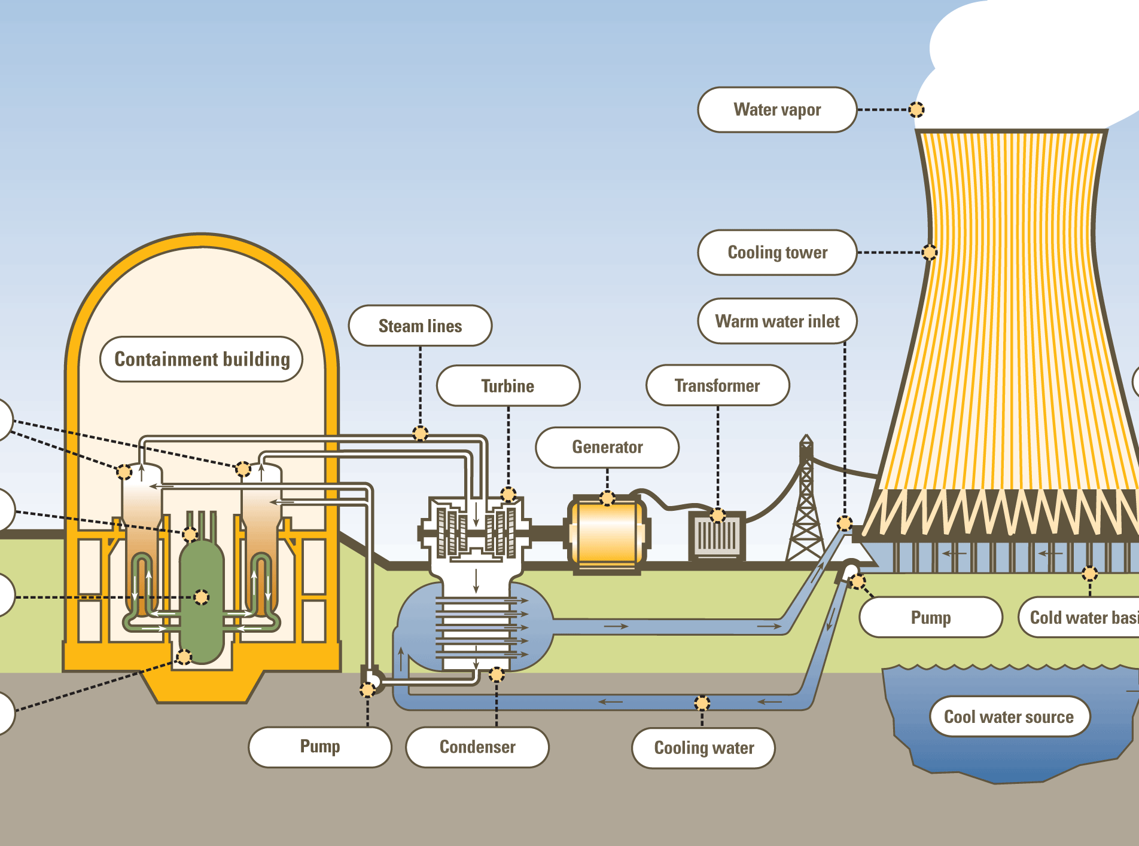
Continue...
Then a turbine changes the kinetic energy of the moving water atoms in steam into mechanical energy.
A generator converts mechanical energy into electrical energy.
The figure shows how a nuclear power plant works.

Slide 13
How Is Fission Harmful or Helpful?
In 1986 an accident occurred at a nuclear power plant at Chernobyl, Ukraine. An explosion blew a large amount of radioactive fuel and waste into the atmosphere. The cloud spread over much of Europe and Asia, and some material even reached North America.
Another reason people are concerned about nuclear power is radioactive waste. The waste includes used fuel rods, chemicals used to process uranium, and even the workers’ protective clothing. Some of this waste will have dangerous levels of radioactivity for thousands of years. That means it must be stored for a very long time before it is safe.

Slide 14
ADVANTAGES AND DISADVANTAGES OF FUSION:
Nuclear fusion is not used yet to make energy electricity for your home. Scientists cannot yet control the high temperatures well enough use fusion. Also, it takes more energy to hold the plasma together than we can get from the fusion. Fusion power plants may exist once these problems are solved.
Advantage is that there is enough fuel in Earth’s water to provide energy for millions of years. Many scientists think that producing energy from fusion will be possible in the future. However, this will require a large amount of money to pay for research.

